Slide 1
-KK Sharma Chairman, KK Sharma Law Offices & ex Director General , CCI
Bargaining Power in FOOD VALUE CHAIN
HSE, St. Petersburg, Russia May 18,2016

Slide 2
Indian Agriculture
HUGE POTENTIAL
~13% of GDP
Employment to approx. 34 % of Indian Population (Total Indian population >1.2 billion)
One of the largest producers in the world-
3rd largest wheat producer; 2nd largest rice producer

Slide 3
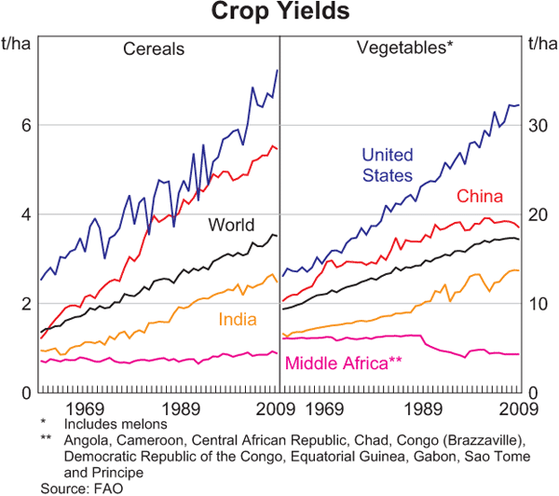
COMPARISONSmparisonld – much below world average

Slide 4
Issues on Supply Side
Small land holdings
Dependence on monsoon
Traditional methods- not mechanised
Middlemen in APMC Mandis- 250% inflation

Slide 5
Bargaining Power
Generally, Farming Class Never Had It
The Kings/Warrior Class
Trading Class- East India Company
British Crown
1947
Story Begins Here

Slide 6
1947 onwards-Story Unfolds
Farmers
Small Holdings,
Powerless-Stereotypes
Monsoon
Zamindars- Premchand- Bullock Story
Population Growth- uneducated
Just Sustenance
Empowerment by Govt.
Legislative
Farmers
Factors of Production- Fertilizers etc.
Crop Insurance etc.

Slide 7
Legislative
Abolition of Intermediaries- Taxation
Tenancy Reforms
Ceiling on Land Holdings
Consolidation of Farm Sizes
Legislative Intent
Growth and promotion of the Agricultural Sector
Empowerment of Farming Class
Outcome Today
Improved
Holy Cow
Taxation

Slide 8
Food Retail
Food and grocery retail accounts to 60% of the total retail in India
Food and grocery retail- Rs. 25,12,962 crores (2014) or apprx USD 40 Billion

Slide 9
Food Value Chain
Some Big Whole Sellers/ Zamindaars
Hapur Mandi
Real Tillers
Hardly Any Power
Empowerment by Govt.
All legislation
Yes, once in bigger groups
Lijjat/Amul etc.

Slide 10
Progression
Like Competition Law
Regulation in the Beginning
Leave Free Once the Markets Mature
Politico Social Reasons
Politics
Latur Water
Farmers’ Suicides-Loans
Sensitive-Tax Issue
Decisions Very Careful
Near Over Protection
Affluents Misusing

Slide 11
Indian Food Retail Sector
Kirana Stores
Supermarkets/ mall based shopping -
Big Bazaar, Spencer
Multibrand stores -
Wal-Mart, Carrefour
E-tailers – Grofers, BigBasket, etc.

Slide 12
Tipping the Bargaining Power?
Type | Advantages
Corporate Retail Giants (Supermarkets) | Holistic Experience Wholesome family outing Broader range of products
Small Scale Retailers (Kirana Stores) | Goodwill Credit till the end of the month Familiarity of Face Familiarity of individual preferences
A superior bargaining power may be amassed by the organised retail sector in the near future

Slide 13
Disrupting E-commerce: 3rd Player
2 models:
Hyperlocal : Grofers, Zopnow
Marketplace: Big Basket, UrDoorstep
New Model
Mandi-Direct: Rocketgrocery.com

Slide 14
Superior Bargaining Power- India
Technology led Revolution
Market situation difficult to determine
Big supermarkets Changing with Technology
In a State of Flux
This provides the Government/Agency to take stock

Slide 15
Government and CCI
CCI needs to be vigilant – social obligation mandated by Competition Act – S. 19(4)(k)
The CCP – probed food and essential commodities – sugar cartelisation, rise in price in essential food items, poultry, vanaspati, etc.
Close check on food supply chain, technological innovation and the integration of the two
Conduct studies in the Sector
Scrape redundant laws and prepare for changing market dynamics

Slide 16
DISRUPTERS
Big Daddies establishing effective Business-to-Business (farmer-processor, processor-retailer) solutions thereby leveraging the core competence of each player in the supply chain
Advent of e-retail provides competition for market share lost by unorganized sector to the organized sector
Success Story – Amul, the Apple Project, etc. - Economies of scale through supply chain integration while redistributing wealth
Anti competitive effect from emerging superior bargaining power can and will be effectively countered by the market in India and the government and CCI if appropriate measures are taken in a timely manner.

Slide 17
Highest retails outlet in the world –over 13 m is 50-100 square feet. It also has the highest number of outlets (11,903) per million inhabitants.
92% belongs to private traditional unorganised players - General stores, kirana stores and street sellers (50-100 sq ft shops)
Organised – Supermarket, hypermarkets, Discount Stores, Government stores, e-tailers- around 5%

Slide 18
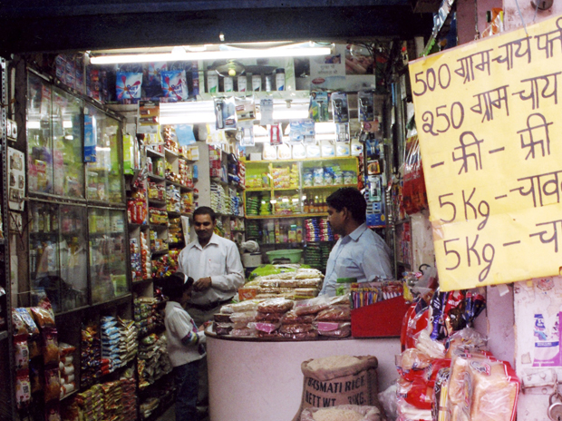
KIRANA
Local family run business
Strong roots in locality
Have strong customer base

Slide 19
E tailers in Food retail
Recent phenomenon
Only in Metros
Two Models-
Inventory based
Through local markets
Varying degree of success

Slide 20
Present bargaining power
NOBODY
May Rapidly Change
Technology A Big Disruptor
Apps with No Inventory May Have the Most Power

Slide 21
Way to Grow -Cooperatives
Leads to integration and consolidation
Economies of scale
Many success stories- Amul, Mahagrapes, Ginger Production in Karbi Anglong District

Slide 22
Contract and Corporate Farming
At infancy
Very successful in integrating the supply chain
Challenges-
Land ceiling laws
Farmers with small land holdings- high transaction cost in executing agreements
Lack of Political will

Slide 23
Various issues
Gradual accumulation of bargaining power – big retail brands
May be of detriment to small farmers
Whether CCI equipped?
Needs More Focus
Less cases till now
Focus on investigation

Slide 24
Competition Law / Government
Majority farmers – poor and illiterate
Government needs to safeguard their rights
Competition Law not sufficient alone
Government needs to issue directives on rates of contract farming, its mechanism, etc.
Agriculture policy to be competition compliant

Slide 25
FUTURE TENSE
Bargaining Power Shift
From Aggregate Intermediaries to
Growing Class, Aggregators and Last Mile Vendor
Agents
New Entrants
Technology
Transparency
On Way Out
Information Transparency
Large Links in Chain
Signs are There

Slide 26
THANK YOU

